Slide 1
Convolutional Neural Network
Can the network be simplified by considering the properties of images?

Slide 2


Why CNN for Image
Some patterns are much smaller than the whole image
A neuron does not have to see the whole image to discover the pattern.
Connecting to small region with less parameters
“beak” detector

Slide 3

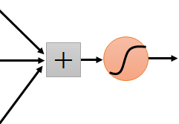
Why CNN for Image
The same patterns appear in different regions.
“upper-left beak” detector
Do almost the same thing
They can use the same set of parameters.
“middle beak” detector

Slide 4


Why CNN for Image
Subsampling the pixels will not change the object
bird
bird
subsampling
We can subsample the pixels to make image smaller
Less parameters for the network to process the image

Slide 5


The whole CNN
cat dog ……
Convolution
Max Pooling
Can repeat many times
Fully Connected Feedforward network
Convolution
Max Pooling
Flatten

Slide 6
The whole CNN
Property 1
Some patterns are much smaller than the whole image
Convolution
Property 2
Max Pooling
The same patterns appear in different regions.
Can repeat many times
Property 3
Convolution
Subsampling the pixels will not change the object
Max Pooling
Flatten

Slide 7
The whole CNN
cat dog ……
Convolution
Max Pooling
Can repeat many times
Fully Connected Feedforward network
Convolution
Max Pooling
Flatten

Slide 8
CNN – Convolution
Those are the network parameters to be learned.
1 | -1 | -1
-1 | 1 | -1
-1 | -1 | 1
1 | 0 | 0 | 0 | 0 | 1
0 | 1 | 0 | 0 | 1 | 0
0 | 0 | 1 | 1 | 0 | 0
1 | 0 | 0 | 0 | 1 | 0
0 | 1 | 0 | 0 | 1 | 0
0 | 0 | 1 | 0 | 1 | 0
Filter 1
Matrix
-1 | 1 | -1
-1 | 1 | -1
-1 | 1 | -1
Filter 2
Matrix
……
6 x 6 image
Each filter detects a small pattern (3 x 3).
Property 1

Slide 9
CNN – Convolution
1 | -1 | -1
-1 | 1 | -1
-1 | -1 | 1
Filter 1
stride=1
1 | 0 | 0 | 0 | 0 | 1
0 | 1 | 0 | 0 | 1 | 0
0 | 0 | 1 | 1 | 0 | 0
1 | 0 | 0 | 0 | 1 | 0
0 | 1 | 0 | 0 | 1 | 0
0 | 0 | 1 | 0 | 1 | 0
3
-1
6 x 6 image

Slide 10
CNN – Convolution
1 | -1 | -1
-1 | 1 | -1
-1 | -1 | 1
Filter 1
If stride=2
1 | 0 | 0 | 0 | 0 | 1
0 | 1 | 0 | 0 | 1 | 0
0 | 0 | 1 | 1 | 0 | 0
1 | 0 | 0 | 0 | 1 | 0
0 | 1 | 0 | 0 | 1 | 0
0 | 0 | 1 | 0 | 1 | 0
3
-3
We set stride=1 below
6 x 6 image

Slide 11
CNN – Convolution
1 | -1 | -1
-1 | 1 | -1
-1 | -1 | 1
Filter 1
stride=1
1 | 0 | 0 | 0 | 0 | 1
0 | 1 | 0 | 0 | 1 | 0
0 | 0 | 1 | 1 | 0 | 0
1 | 0 | 0 | 0 | 1 | 0
0 | 1 | 0 | 0 | 1 | 0
0 | 0 | 1 | 0 | 1 | 0
3
-1
-3
-1
-3
1
0
-3
-3
-3
0
1
3
-2
-2
-1
6 x 6 image
Property 2

Slide 12
CNN – Convolution
-1 | 1 | -1
-1 | 1 | -1
-1 | 1 | -1
Filter 2
stride=1
Do the same process for every filter
1 | 0 | 0 | 0 | 0 | 1
0 | 1 | 0 | 0 | 1 | 0
0 | 0 | 1 | 1 | 0 | 0
1 | 0 | 0 | 0 | 1 | 0
0 | 1 | 0 | 0 | 1 | 0
0 | 0 | 1 | 0 | 1 | 0
3
-1
-3
-1
-1
-1
-1
-1
-3
1
0
-3
-1
-1
-2
1
Feature
Map
-3
-3
0
1
-1
-1
-2
1
3
-2
-2
-1
6 x 6 image
-1
0
-4
3
4 x 4 image

Slide 13
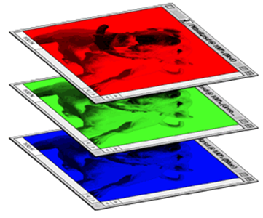
CNN – Colorful image
1 | -1 | -1
-1 | 1 | -1
-1 | -1 | 1
-1 | 1 | -1
-1 | 1 | -1
-1 | 1 | -1
1 | -1 | -1
-1 | 1 | -1
-1 | -1 | 1
-1 | 1 | -1
-1 | 1 | -1
-1 | 1 | -1
1 | -1 | -1
-1 | 1 | -1
-1 | -1 | 1
-1 | 1 | -1
-1 | 1 | -1
-1 | 1 | -1
Filter 1
Filter 2
Colorful image
1 | 0 | 0 | 0 | 0 | 1
0 | 1 | 0 | 0 | 1 | 0
0 | 0 | 1 | 1 | 0 | 0
1 | 0 | 0 | 0 | 1 | 0
0 | 1 | 0 | 0 | 1 | 0
0 | 0 | 1 | 0 | 1 | 0
1 | 0 | 0 | 0 | 0 | 1
0 | 1 | 0 | 0 | 1 | 0
0 | 0 | 1 | 1 | 0 | 0
1 | 0 | 0 | 0 | 1 | 0
0 | 1 | 0 | 0 | 1 | 0
0 | 0 | 1 | 0 | 1 | 0
1 | 0 | 0 | 0 | 0 | 1
0 | 1 | 0 | 0 | 1 | 0
0 | 0 | 1 | 1 | 0 | 0
1 | 0 | 0 | 0 | 1 | 0
0 | 1 | 0 | 0 | 1 | 0
0 | 0 | 1 | 0 | 1 | 0

Slide 14
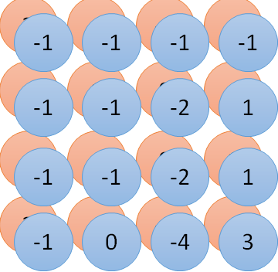
Convolution v.s. Fully Connected
1 | 0 | 0 | 0 | 0 | 1
0 | 1 | 0 | 0 | 1 | 0
0 | 0 | 1 | 1 | 0 | 0
1 | 0 | 0 | 0 | 1 | 0
0 | 1 | 0 | 0 | 1 | 0
0 | 0 | 1 | 0 | 1 | 0
1 | -1 | -1
-1 | 1 | -1
-1 | -1 | 1
-1 | 1 | -1
-1 | 1 | -1
-1 | 1 | -1
convolution
image
1 | 0 | 0 | 0 | 0 | 1
0 | 1 | 0 | 0 | 1 | 0
0 | 0 | 1 | 1 | 0 | 0
1 | 0 | 0 | 0 | 1 | 0
0 | 1 | 0 | 0 | 1 | 0
0 | 0 | 1 | 0 | 1 | 0
Fully-connected
……
……

Slide 15
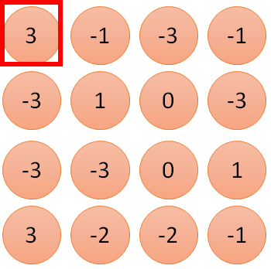
1 | -1 | -1
-1 | 1 | -1
-1 | -1 | 1
1:
1
Filter 1
2:
0
3:
0
3
4:
0
1 | 0 | 0 | 0 | 0 | 1
0 | 1 | 0 | 0 | 1 | 0
0 | 0 | 1 | 1 | 0 | 0
1 | 0 | 0 | 0 | 1 | 0
0 | 1 | 0 | 0 | 1 | 0
0 | 0 | 1 | 0 | 1 | 0
…
7:
0
8:
1
9:
0
10:
0
…
13:
0
6 x 6 image
14:
0
Less parameters!
15:
Only connect to 9 input, not fully connected
1
16:
1
…

Slide 16
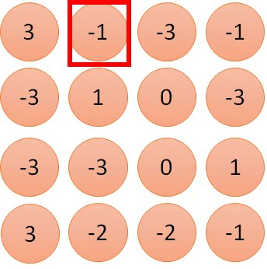
1 | -1 | -1
-1 | 1 | -1
-1 | -1 | 1
1:
1
Filter 1
2:
0
3:
0
3
4:
0
1 | 0 | 0 | 0 | 0 | 1
0 | 1 | 0 | 0 | 1 | 0
0 | 0 | 1 | 1 | 0 | 0
1 | 0 | 0 | 0 | 1 | 0
0 | 1 | 0 | 0 | 1 | 0
0 | 0 | 1 | 0 | 1 | 0
…
7:
0
8:
1
-1
9:
0
10:
0
…
13:
0
6 x 6 image
14:
0
Less parameters!
15:
1
16:
1
Shared weights
Even less parameters!
…

Slide 17
The whole CNN
cat dog ……
Convolution
Max Pooling
Can repeat many times
Fully Connected Feedforward network
Convolution
Max Pooling
Flatten

Slide 18
CNN – Max Pooling
1 | -1 | -1
-1 | 1 | -1
-1 | -1 | 1
-1 | 1 | -1
-1 | 1 | -1
-1 | 1 | -1
Filter 1
Filter 2
3
-1
-3
-1
-1
-1
-1
-1
-3
1
0
-3
-1
-1
-2
1
-3
-3
0
1
-1
-1
-2
1
3
-2
-2
-1
-1
0
-4
3

Slide 19
CNN – Max Pooling
New image
but smaller
1 | 0 | 0 | 0 | 0 | 1
0 | 1 | 0 | 0 | 1 | 0
0 | 0 | 1 | 1 | 0 | 0
1 | 0 | 0 | 0 | 1 | 0
0 | 1 | 0 | 0 | 1 | 0
0 | 0 | 1 | 0 | 1 | 0
Conv
3
0
-1
1
Max
Pooling
3
1
0
3
2 x 2 image
6 x 6 image
Each filter
is a channel

Slide 20
The whole CNN
3
0
-1
1
Convolution
3
1
0
3
Max Pooling
Can repeat many times
A new image
Convolution
Smaller than the original image
The number of the channel is the number of filters
Max Pooling

Slide 21
The whole CNN
cat dog ……
Convolution
Max Pooling
A new image
Fully Connected Feedforward network
Convolution
Max Pooling
A new image
Flatten

Slide 22
Flatten
3
0
1
3
0
-1
1
3
3
1
-1
0
3
Flatten
1
Fully Connected Feedforward network
0
3

Slide 23
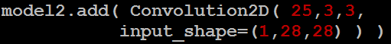
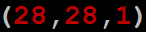
CNN in Keras
Only modified the network structure and input format (vector -> 3-D tensor)
input
Convolution
1 | -1 | -1
-1 | 1 | -1
-1 | -1 | 1
-1 | 1 | -1
-1 | 1 | -1
-1 | 1 | -1
There are 25 3x3 filters.
……
Max Pooling
Input_shape = ( 28 , 28 , 1)
28 x 28 pixels
1: black/white, 3: RGB
Convolution
3
-1
3
Max Pooling
-3
1

Slide 24
CNN in Keras
Only modified the network structure and input format (vector -> 3-D tensor)
input
1 x 28 x 28
Convolution
How many parameters for each filter?
9
25 x 26 x 26
Max Pooling
25 x 13 x 13
Convolution
How many parameters for each filter?
225
50 x 11 x 11
Max Pooling
50 x 5 x 5

Slide 25
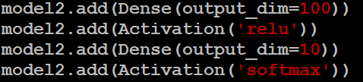
CNN in Keras
Only modified the network structure and input format (vector -> 3-D tensor)
input
1 x 28 x 28
output
Convolution
25 x 26 x 26
Fully Connected Feedforward network
Max Pooling
25 x 13 x 13
Convolution
50 x 11 x 11
Max Pooling
1250
50 x 5 x 5
Flatten

Slide 26
Live Demo

Slide 27
Auto-encoder for CNN
Unpooling & Deconvolution
As close as possible
Deconvolution
Unpooling
Convolution
Deconvolution
Pooling
Unpooling
Convolution
code
Deconvolution
Pooling
Notes:
這個圖可能有問題!

Slide 28
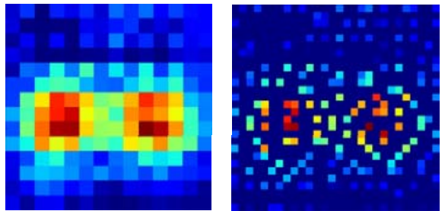
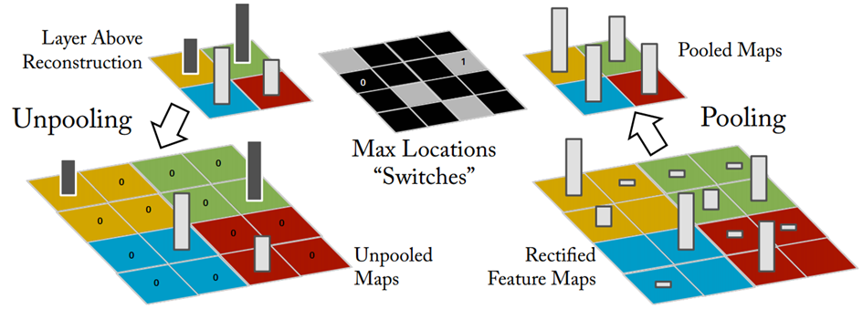
Unpooling
14 x 14
28 x 28
Alternative: simply repeat the values
Source of image : https://leonardoaraujosantos.gitbooks.io/artificial-inteligence/content/image_segmentation.html

Slide 29
Deconvolution
Actually, deconvolution is convolution.
+
+
+
=
+

Slide 30
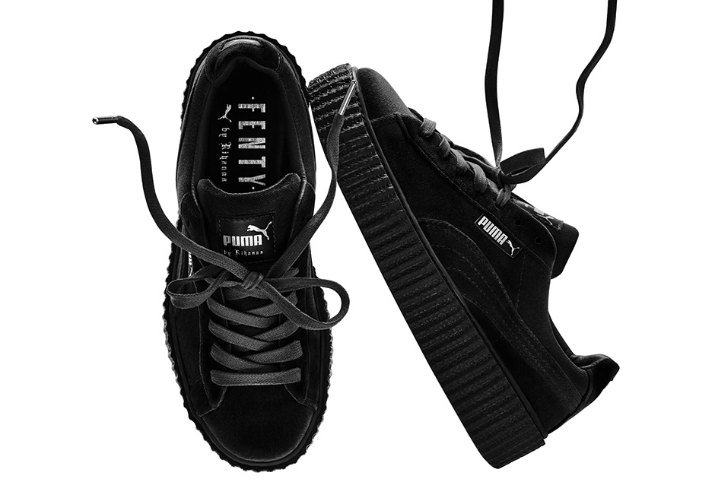

What does machine learn?
球鞋
美洲獅
http://newsneakernews.wpengine.netdna-cdn.com/wp-content/uploads/2016/11/rihanna-puma-creeper-velvet-release-date-02.jpg

Slide 31
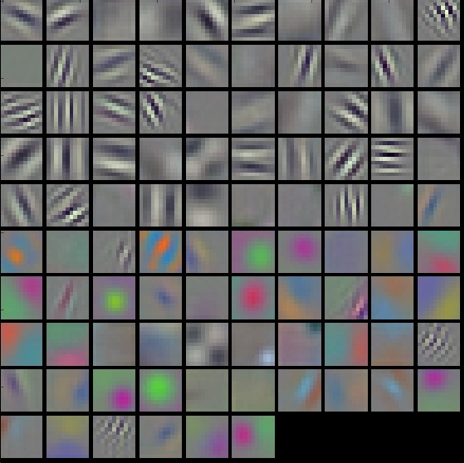
First Convolution Layer
Typical-looking filters on the trained first layer
11 x 11
(AlexNet)
http://cs231n.github.io/understanding-cnn/
Notes:
The color/grayscale features are clustered because the AlexNet contains two separate streams of processing, and an apparent consequence of this architecture is that one stream develops high-frequency grayscale features and the other low-frequency color features
Typical-looking filters on the first CONV layer (left), and the 2nd CONV layer (right) of a trained AlexNet. Notice that the first-layer weights are very nice and smooth, indicating nicely converged network.

Slide 32
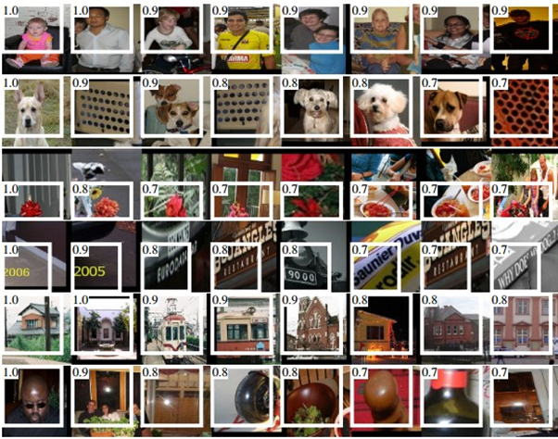
How about higher layers?
Which images make a specific neuron activate
Ross Girshick, Jeff Donahue, Trevor Darrell, Jitendra Malik, “Rich feature hierarchies for accurate object detection and semantic segmentation”, CVPR, 2014
Notes:
From “rcnn”
Maximally activating images for some POOL5 (5th pool layer) neurons of an AlexNet. The activation values and the receptive field of the particular neuron are shown in white. (In particular, note that the POOL5 neurons are a function of a relatively large portion of the input image!) It can be seen that some neurons are responsive to upper bodies, text, or specular highlights.

Slide 33
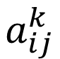
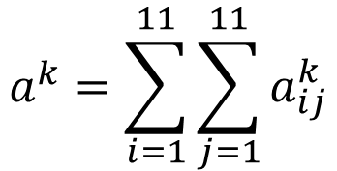
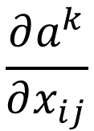
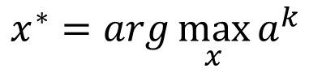
What does CNN learn?
$$\frac{∂a^{k}}{∂x_{ij}}$$
The output of the k-th filter is a 11 x 11 matrix.
x
input
Degree of the activation of the k-th filter:
$$a^{k}=\sum_{i=1}^{11}{\sum_{j=1}^{11}{a_{ij}^{k}}}$$
25 3x3 filters
Convolution
$$x^{∗}=arg\max_{x}{a^{k}}$$
(gradient ascent)
11
Max Pooling
3
-1
……
-1
50 3x3 filters
$$a_{ij}^{k}$$
Convolution
-3
1
……
-3
11
50 x 11 x 11
……
……
……
Max Pooling
3
-2
……
-1

Slide 34
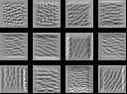
What does CNN learn?
$$\frac{∂a^{k}}{∂x_{ij}}$$
The output of the k-th filter is a 11 x 11 matrix.
input
Degree of the activation of the k-th filter:
$$a^{k}=\sum_{i=1}^{11}{\sum_{j=1}^{11}{a_{ij}^{k}}}$$
25 3x3 filters
Convolution
$$x^{∗}=arg\max_{x}{a^{k}}$$
(gradient ascent)
Max Pooling
50 3x3 filters
Convolution
50 x 11 x 11
Max Pooling
For each filter

Slide 35
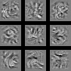
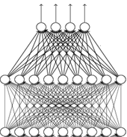
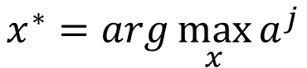
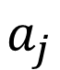
What does CNN learn?
input
Find an image maximizing the output of neuron:
Convolution
$$x^{∗}=arg\max_{x}{a^{j}}$$
Max Pooling
Convolution
Max Pooling
flatten
Each figure corresponds to a neuron
$$a_{j}$$

Slide 36
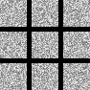
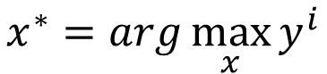
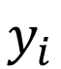
What does CNN learn?
input
$$x^{∗}=arg\max_{x}{y^{i}}$$
Can we see digits?
Convolution
Max Pooling
0
1
2
Convolution
Max Pooling
3
4
5
flatten
6
7
8
Deep Neural Networks are Easily Fooled
https://www.youtube.com/watch?v=M2IebCN9Ht4
$$y_{i}$$

Slide 37
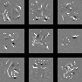
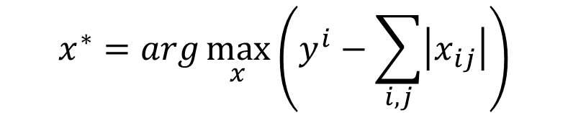
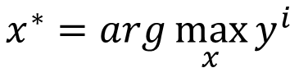
What does CNN learn?
Over all pixel values
$$x^{∗}=arg\max_{x}\left(y^{i}−\sum_{i,j}{\left|x_{ij}\right|}\right)$$
$$x^{∗}=arg\max_{x}{y^{i}}$$
0
1
2
0
1
2
3
4
5
3
4
5
6
7
8
6
7
8

Slide 38
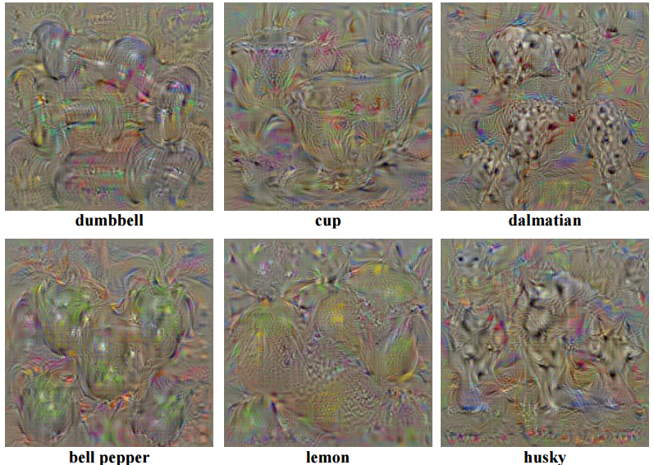
Karen Simonyan, Andrea Vedaldi, Andrew Zisserman, “Deep Inside Convolutional Networks: Visualising Image Classification Models and Saliency Maps”, ICLR, 2014

Slide 39
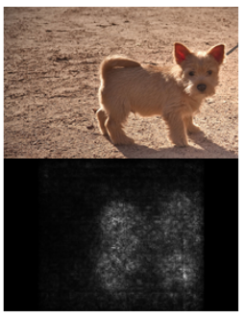
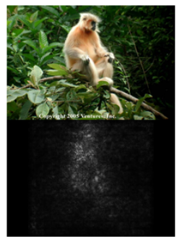
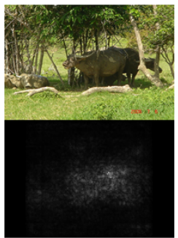
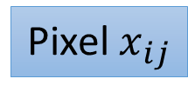
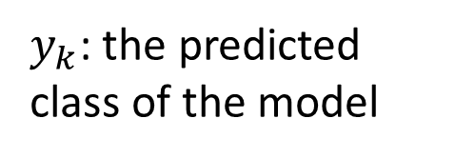
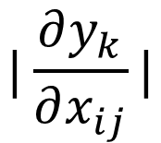
$$|\frac{∂y_{k}}{∂x_{ij}}|$$
$y_{k}$: the predicted class of the model
Pixel $x_{ij}$
Karen Simonyan, Andrea Vedaldi, Andrew Zisserman, “Deep Inside Convolutional Networks: Visualising Image Classification Models and Saliency Maps”, ICLR, 2014

Slide 40
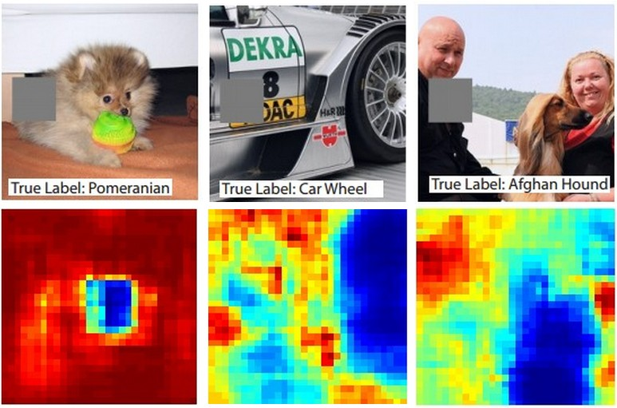
Reference: Zeiler, M. D., & Fergus, R. (2014). Visualizing and understanding convolutional networks. In Computer Vision–ECCV 2014 (pp. 818-833)

Slide 41
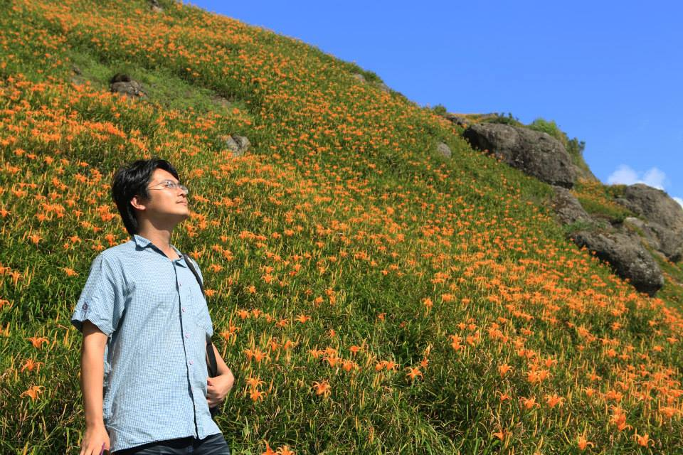
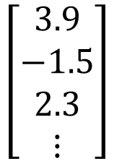
Deep Dream
CNN
Modify image
Given a photo, machine adds what it sees ……
$$\left[\begin{aligned}3.9 \\ −1.5 \\ 2.3 \\ ⋮\end{aligned}\right]$$
CNN exaggerates what it sees
http://deepdreamgenerator.com/
Notes:
http://speech.ee.ntu.edu.tw/dokuwiki/lib/exe/fetch.php?media=speech:meeting:paper_report:paper_report_2015-08-12.pdf

Slide 42

Deep Dream
Given a photo, machine adds what it sees ……
http://deepdreamgenerator.com/

Slide 43
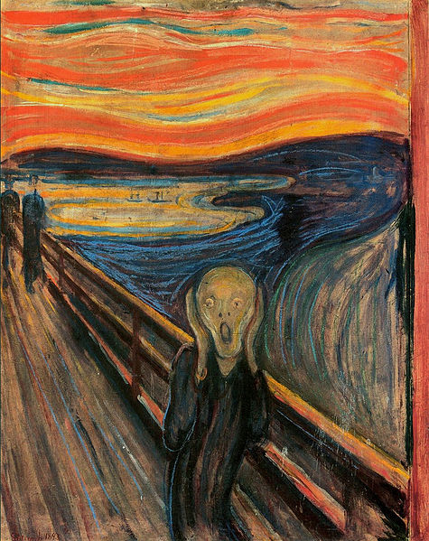
Deep Style
Given a photo, make its style like famous paintings
https://dreamscopeapp.com/

Slide 44
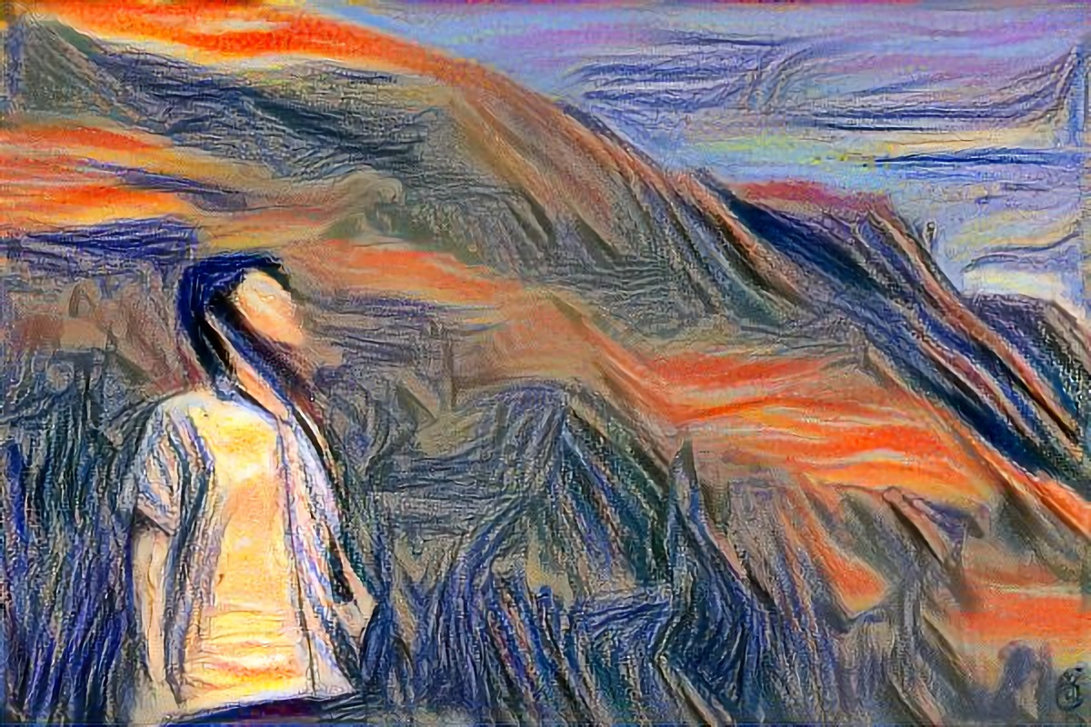
Deep Style
Given a photo, make its style like famous paintings
https://dreamscopeapp.com/

Slide 45

Deep Style
CNN
CNN
A Neural Algorithm of Artistic Style
https://arxiv.org/abs/1508.06576
content
style
CNN
?

Slide 46
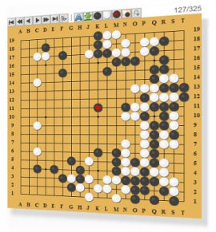
More Application: Playing Go
Network
Next move
(19 x 19 positions)
19 x 19 matrix (image)
19 x 19 vector
19 x 19 vector
Fully-connected feedforward network can be used
Black: 1
white: -1
none: 0
But CNN performs much better.

Slide 47
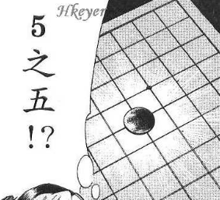


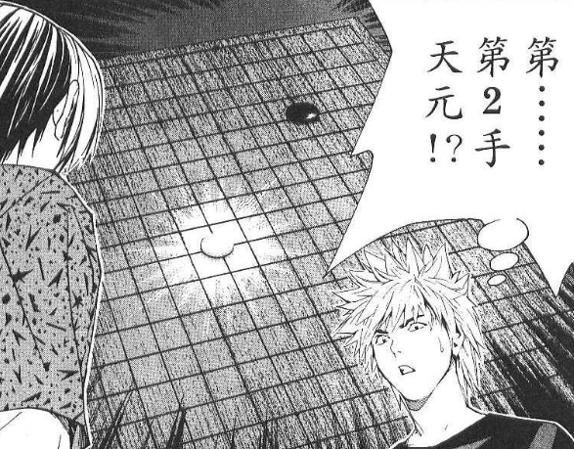
More Application: Playing Go
record of previous plays
Training:
黑: 5之五
白: 天元
黑: 五之5 …
Target:
“天元” = 1
else = 0
CNN
Target:
“五之 5” = 1
else = 0
CNN

Slide 48
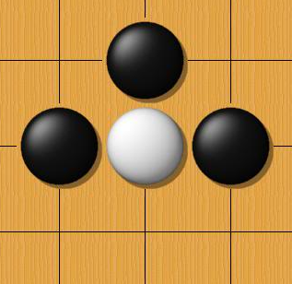
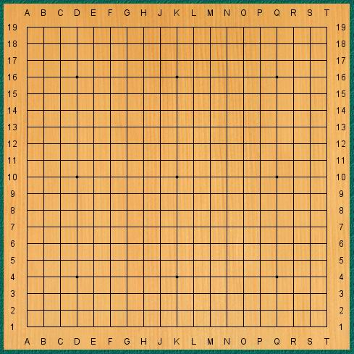
Why CNN for playing Go?
Some patterns are much smaller than the whole image
The same patterns appear in different regions.
Alpha Go uses 5 x 5 for first layer

Slide 49
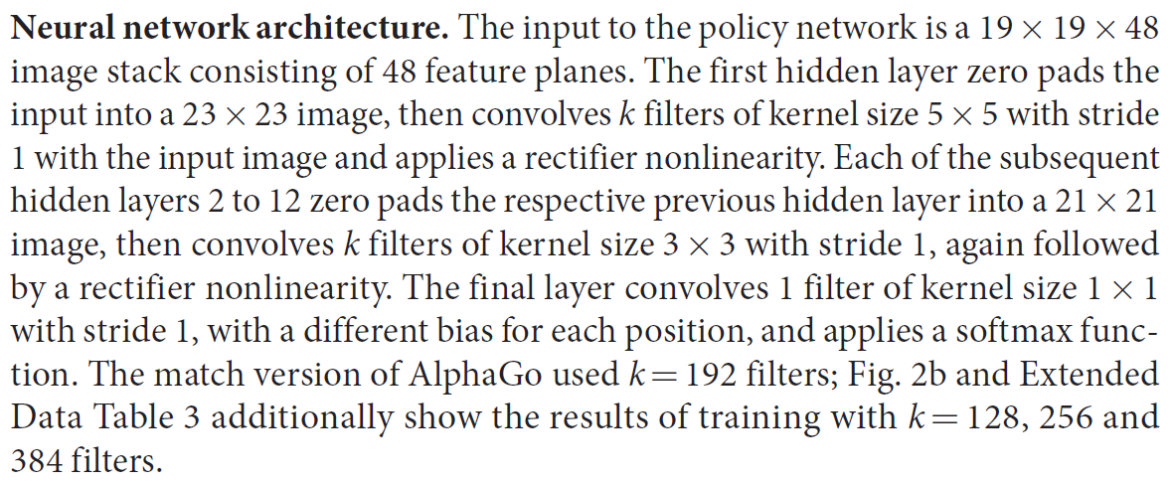
Why CNN for playing Go?
Subsampling the pixels will not change the object
Max Pooling
How to explain this???
Alpha Go does not use Max Pooling ……
Notes:
Very good example for desing your network

Slide 50
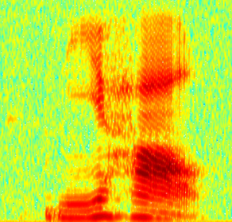
More Application: Speech
The filters move in the frequency direction.
CNN
Frequency
Image
Time
Spectrogram

Slide 51
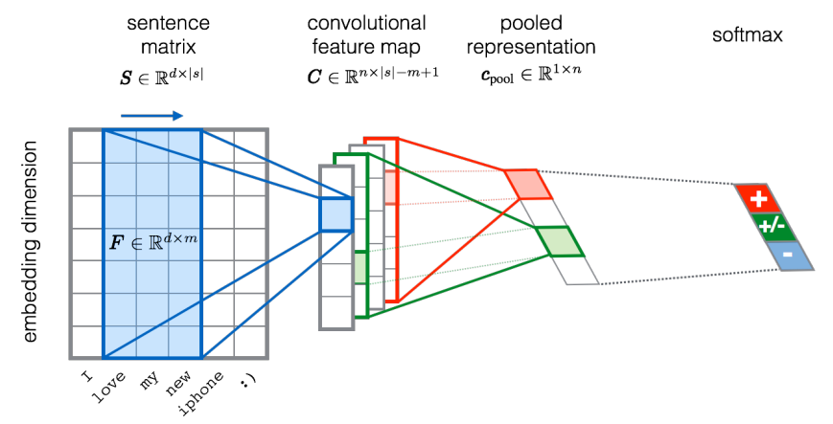
More Application: Text
?
Source of image: http://citeseerx.ist.psu.edu/viewdoc/download?doi=10.1.1.703.6858&rep=rep1&type=pdf

Slide 52
Spatial Transformer Layer

Slide 53
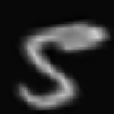
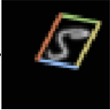



Spatial Transformer Layer
CNN is not invariant to scaling and rotation
CNN
5
CNN
6
NN layer
Can also transform feature map
End-to-end learn
Notes:
Ref: Max Jaderberg, Karen Simonyan, Andrew Zisserman, Koray Kavukcuoglu, “Spatial Transformer Networks”, NIPS, 2015
Ref: Max Jaderberg, Karen Simonyan, Andrew Zisserman, Koray Kavukcuoglu, “Spatial Transformer Networks”, NIPS, 2015
Training and test randomly rotated by (+/- 90°)

Slide 54




Slide 55


Slide 56

Capsule
Sara Sabour, Nicholas Frosst, Geoffrey E. Hinton, “Dynamic Routing Between Capsules”, NIPS, 2017
Notes:
另一個想要換掉反像傳播的例子
http://bangqu.com/b5o8C3.html
https://github.com/XifengGuo/CapsNet-Keras
https://www.reddit.com/r/MachineLearning/comments/78zvc4/r_171009829_dynamic_routing_between_capsules/
https://hackernoon.com/what-is-a-capsnet-or-capsule-network-2bfbe48769cc
https://github.com/XifengGuo/CapsNet-Keras
https://github.com/gram-ai/capsule-networks
https://www.youtube.com/watch?v=xVhD2OBqoyg
Each layer will be divided into many small groups of neurons called “capsules” and each node in the parse tree will correspond to an active capsule.
Using an iterative routing process, each active capsule will choose a capsule in the layer above to be its parent in the tree. For the higher levels of a visual system, this iterative process will be solving the problem of assigning parts to wholes.
Hinton注意到的一個有趣的事實是，目前大多數神經解剖學研究都支持（大部分哺乳類，特別是靈長類）大腦皮層中大量存在稱為Cortical minicolumn的柱狀結構（皮層
微柱），其內部含有上百個神經元，並存在內部分層。這意味著人腦中的一層並不是類似現在NN的一層，而是有復雜的內部結
https://zhuanlan.zhihu.com/p/29435406構。

Slide 57
Capsule
A neuron detects a specific pattern.
Neuron A
Neuron B
Neuron: output a value, Capsule: output a vector
Cap
$$v^{1}$$
Detect one type of patterns
$$\left[\begin{aligned}1.0 \\ ⋮\end{aligned}\right]$$
Cap
$$v$$
$$\left[\begin{aligned}−1.0 \\ ⋮\end{aligned}\right]$$
Cap
$$v^{2}$$
Each dimension of v represents the characteristics of patterns.
The norm of v represents the existence.
Notes:
The output of each node is a vector, not a scalar. The vector’s direction represent a kind of entity, and its length stands for the probability that the entity exists.

Slide 58
Capsule
$$u^{1}=W^{1}v^{1}$$
$$u^{2}=W^{2}v^{2}$$
$$s=c_{1}u^{1}+c_{2}u^{2}$$
$$v=\frac{{\left\|s\right\|}^{2}}{1+{\left\|s\right\|}^{2}}\frac{s}{\left\|s\right\|}$$
$$v=Squash\left(s\right)$$
$$v^{1}$$
$$u^{1}$$
$$×W^{1}$$
$$×c_{1}$$
Squashing
$$s$$
$$v$$
+
$$v^{2}$$
$$u^{2}$$
$$×W^{2}$$
$$×c_{2}$$
coupling
coefficients
c are determined by dynamic routing during the testing stage.
c.f. pooling

Slide 59

Capsule
Minimize reconstruction error
Capsule can also be convolutional.
Simply replace filter with capsule
Output layer and loss
NN
x1
x0
Cap
$$v^{1}$$
$$\left\|v^{1}\right\|$$
Confidence of “1”
CapsNet
Cap
$$v^{2}$$
$$\left\|v^{2}\right\|$$
Confidence of “2”
……
……

Slide 60

Experimental Results
MNIST
Each example is an MNIST digit with a random small affine transformation.
However, models were never trained with affine transformations
CapsNet achieved 79% accuracy on the affnist test set.
A traditional convolutional model with a similar number of parameters which achieved 66%.

Slide 61
Discussion
Invariance v.s. Equivariance
NN
NN
NN
NN
Invariance
Equivariance

Slide 62
Discussion
I know the difference, but I do not react to it.
Both large
$$\left\|v^{1}\right\|$$
Can be different
$$\left\|v^{1}\right\|$$
Invariance v.s. Equivariance
I don’t know the difference.
$$v^{1}$$
$$v^{1}$$
3
3
Cap
Cap
3
-1
-3
-1
-3
1
0
3
Max pooling has invariance, but not equivariance.
Capsule has both invariance and equivariance.
Notes:
What we needed was not invariance but equivariance. Invariance makes a CNN tolerant to small changes in the viewpoint. Equivariance makes a CNN understand the rotation or proportion change and adapt itself accordingly so that the spatial positioning inside an image is not lost. A ship will still be a smaller ship but the CNN will reduce its size to detect that. This leads us to the recent advancement of Capsule Networks.
The brain must have a mechanism for “routing” low level visual information to what it believes is the best capsule for handling it.
有一童子名神會。襄陽高氏子。年十三。自玉泉來參禮。師曰。知識遠來艱辛。還將得本來否。若有本則合識主。試說看。會曰。以無住為本。見即是主。師曰。這沙彌爭合取次語。會乃問曰。和尚坐禪。還見不見。師以拄杖打三下。云。吾打汝是痛不痛。對曰。亦痛亦不痛。師曰。吾亦見亦不見。神會問。如何是亦見亦不見。師云。吾之所見。常見自心過愆。不見他人是非好惡。是以亦見亦不見。汝言亦痛亦不痛如何。汝若不痛。同其木石。若痛。則同凡夫。即起恚恨。汝向前見不見是二邊。痛不痛是生滅。汝自性且不見。敢爾弄人。神會禮拜悔謝。
頓漸品第八

